Slide 1
Student Veterans of America
Yesterday’s Warriors | Today’s Scholars | Tomorrow’s Leaders

Slide 2
Why we are here
SVA provides military veterans with the resources, support, and advocacy needed to succeed in higher education and following graduation with the hope that all veterans will succeed in higher education, achieve their academic goals, and gain meaningful employment.
The founders of SVA came together in 2007 in response to the growing need of returning veterans for support and resources necessary to gain education.
Student veterans from 20 schools met in Chicago in 2008, establishing the first conference, and birth, of SVA.
These founders played a critical role in educating the public about the need for the Post-9/11 G.I. Bill, influencing lawmakers, and ultimately the bill’s signing.
Notes:
Customize this slide based on the audience.

Slide 3
Who are student veterans?
27% are women
46% have children
80% are over age 25
83% attend a public institution
45% are married
90% enlisted
*2016 SVA Spotlight Survey
Over 1 million are receiving G.I. Bill benefits, over 500,000 of them are on SVA campuses
bit.ly/svaresearch
Example text here.

Slide 5
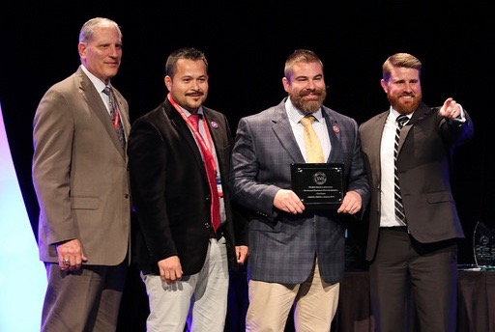
Supporting Students
SVA supports a chapter network of over 1,300 schools in 50 states and 4 countries representing over 500,000 student veterans.
SVA empowers veterans to be informed consumers of higher education and make the most of their G.I. Bill benefits as they transition to civilian life.
SVA invests in high-impact programs that sustain chapters and empower student veterans to achieve their academic goals.
The heart of SVA is the student-led chapter.
bit.ly/svachapterdirectory

Slide 6
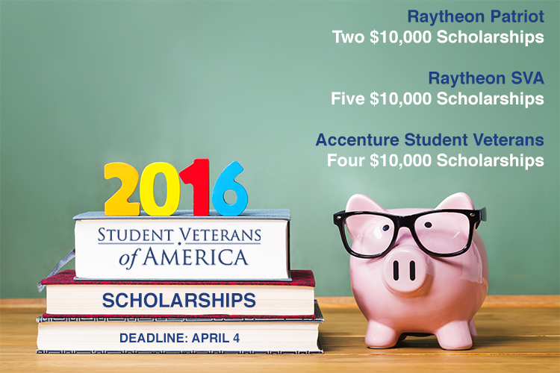
Funding Scholarships
SVA has awarded over $1 million to 111 SVA Scholars since 2011.
By partnering with top corporate sponsors, more student veterans become SVA scholars each semester.
bit.ly/svascholarships2016

Slide 7
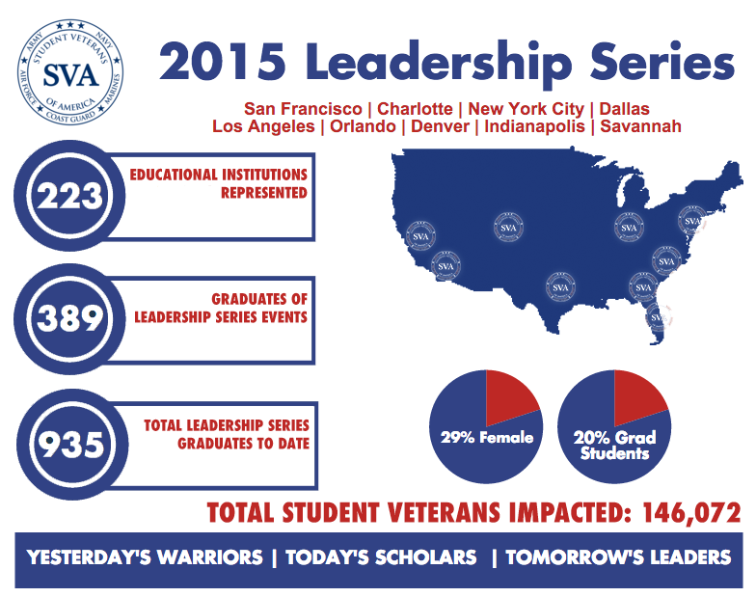
Training Tomorrow’s Leaders
The Leadership Institute Series is an annual chapter training program which consists of razor-focused multi-day events which teach skills such as:
Chapter management
Budgeting
Strategic planning
bit.ly/svaprograms

Slide 8
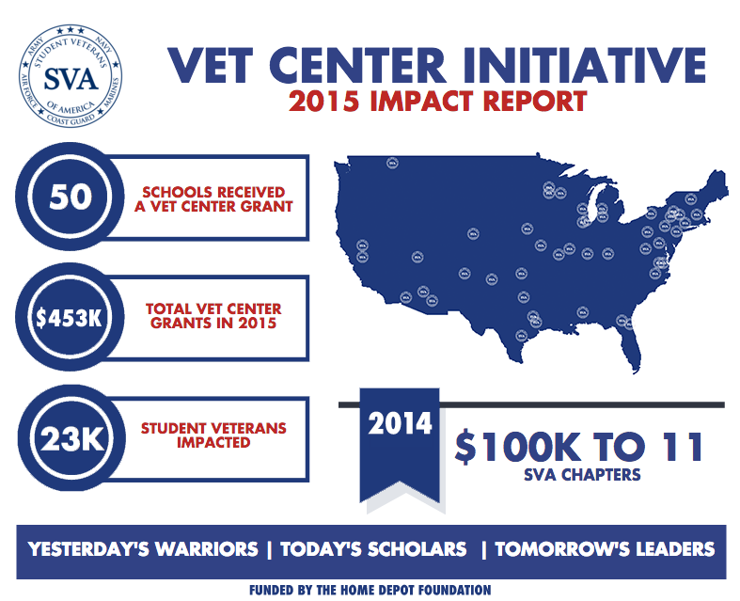
Building Vet Centers
In two years, SVA has awarded $553,000 to 61 schools to build Vet Centers.
In 2016, SVA will build Vet Centers on 50 more campuses.
bit.ly/vcisva
Notes:
A Vet Center is a common place for student veterans on campus to study and socialize.

Slide 9
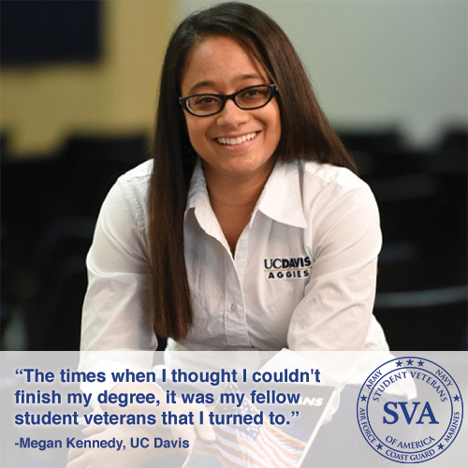
Telling Their Stories
SVA is dedicated to sharing the success of student veterans across the country by engaging in strategic media opportunities, and by telling the stories of our chapters and members.
bit.ly/svavoices

Slide 10
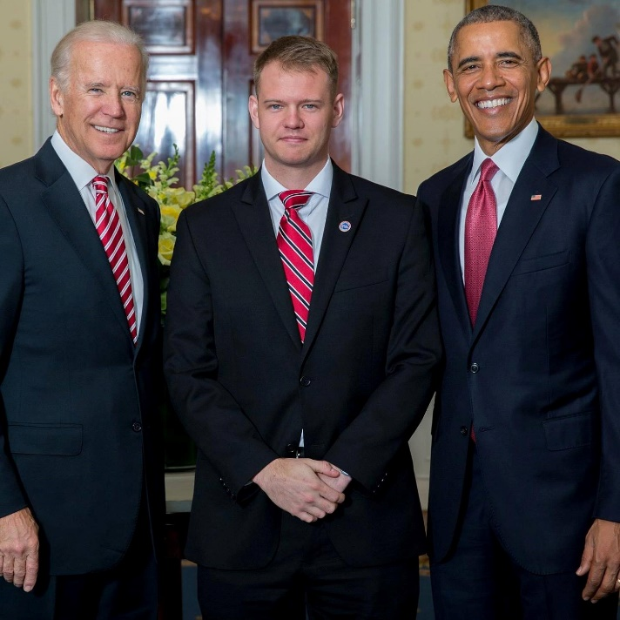
Protecting the G.I. Bill
SVA's Government Affairs team advises lawmakers and advocates in eight issue areas, like student debt and STEM fields.
The annual VFW-SVA Legislative Fellowship invites 10 student veterans to Washington, D.C. to advocate on Capitol Hill.
bit.ly/svapolicypriorities

Slide 11
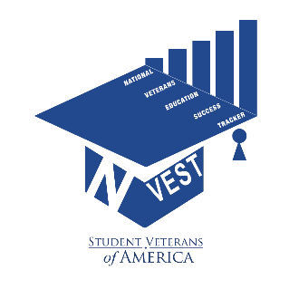
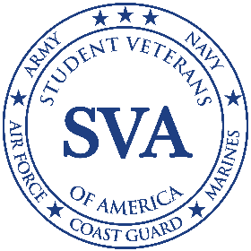
Conducting Groundbreaking Research
In 2014, SVA released the Million Records Project (MRP) which provided near real-time data for policymakers, service providers, institutions of higher learning, and the general public for the first time in history.
SVA will doubled down its efforts by launching two new research initiatives in 2016:
The National Veteran Education Success Tracker (NVEST) will build on MRP by adding level of education, majors and ultimately the completion rates of Post 9/11 GI Bill recipients to our knowledge bank.
The SVA Spotlight survey provides annual demographic data on the student veteran population.
bit.ly/svaresearch

Slide 12
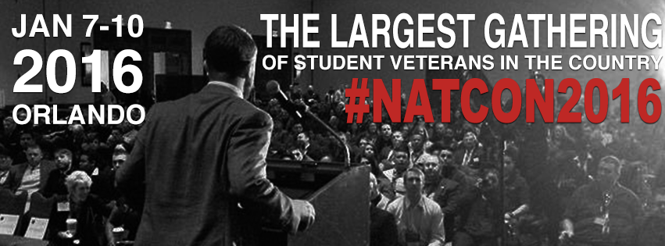
SVA Annual National Conference
The SVA National Conference is the largest gathering of student veterans in the country, with over 1,500 attending in 2016. Our 2017 National Conference will be held January 5-8, 2017 in Anaheim, California.
bit.ly/natcontestimonials

Slide 13
Stay in Touch
www.studentveterans.org
Facebook.com/StudentVets
@StudentVets
@StudentVeterans
Email us: contact@studentveterans.org
Call us: 202-223-4710

