Slide 1
Division of Service-Disabled Veterans’ Business Development
Ken Williams
Executive Director

Slide 2
Service-Disabled Veteran-Owned Business Act

Slide 3
What?
“Achieve a statewide goal for participation on state contracts by service-disabled veteran-owned business enterprises of six percent.”
Service-Disabled Veteran-Owned Business Act (Chapter 22 of the Laws of 2014)

Slide 4
Why?
“This new law sets an ambitious and aggressive goal to make businesses owned by disabled veterans a more active part of state contracting and gives our heroes the recognition that they truly deserve.”
Governor Andrew M. Cuomo

Slide 5
Who?
Honorably discharged veterans including NY Guard and NY Militia and/or Reserves
Service-connected disability of 10% or greater
At least 51% owned by one or more service-disabled veterans (SDVs)
Certified by the Division of Service-Disabled Veterans’ Business Development (DSDVBD)
Significant NY business presence
Other qualifying criteria

Slide 7
Breadth of Specialized Services
App Development and Video Production
Automotive Repair/Tow Service
Copywriting
Construction Professional Business Consultant
CPR/First Aid/Safety Training
Custodial/Janitorial
Educational Services
Energy Consulting
Environmental Waste Management Consulting
Environmental Quality Services
Equipment/Vehicle Leasing
Forensic Products and Training, Lab Supply
Freight/Hauling
Home Inspections
Interoperable Comm. Consulting
Law Firm
Leadership/Management Consulting
Life Coach
Line Striping
Library Services
Logistical Consulting
Machine Shop
Marketing Consultant
Medical/Healthcare Consulting
Mortuary Services
Navigational Systems Support
Occupational Therapist
Pest Control
Photographer
Printing/Graphics/Marketing
Property Management
Real Estate
Safety Equipment and Vehicle Sales/Service
Screen Printing and Embroidery
Security Services
Staffing
Telecommunications
Transcription Services
Transportation/Rail Consultant
Unmanned Aerial Systems Training
Utility Control Systems, Security, Microgrids

Slide 8
When?
NOW
The state-wide rollout began April 1st

Slide 9
History Overview
Enacted in May of 2014 including set-aside provisions
Established a SDVOB participation goal of 6%
OGS charged with the implementation statewide
DSDVBD formed and staffed within OGS
FY 2015/2016 pilot rollout completed successfully
All NYS Agencies and Authorities engaged for FY 2016/2017
Other entities engaged:
Office of the NYS Comptroller
Port Authority of NY and NJ
Nassau County

Slide 10
Results to Date
FY 2015/2016 saw over $23 million in contract awards
34% (69 of the 233 SDVOBs) certified at the end of the first year were already engaged with work with NYS
State-wide rollout effective April 1st, 2016
97 Agencies and Authorities have submitted Goal Plans describing how they will meet their 6% goal

Slide 11
Contracting Opportunities

Slide 12
The NYS SDVOB Database
Once Certified by DSDVBD:
Business is listed as a NYS SDVOB on the OGS website www.ogs.ny.gov and emailed to purchasing people engaged with the program
SDVOB lists business on the NYS Contract Reporter
Database is searched by contract specialists and contractors to identify opportunities for SDVOBs

Slide 13
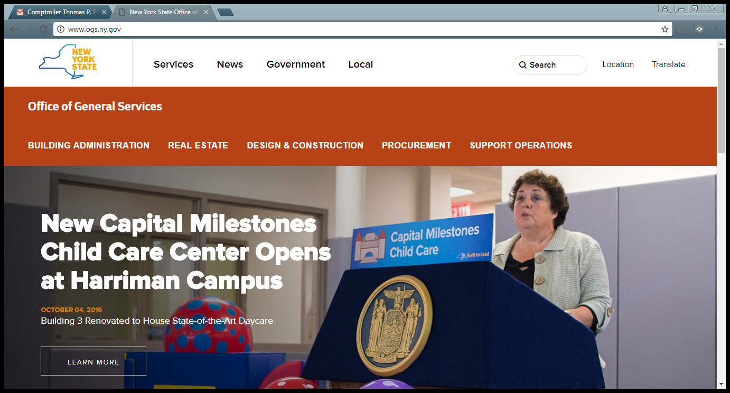
Scroll Down

Slide 14
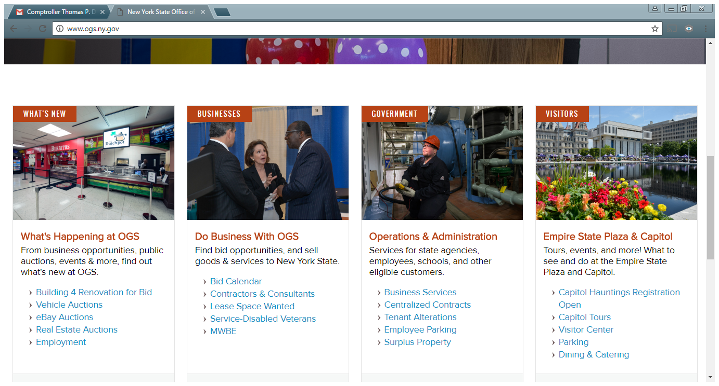
Click Here

Slide 15
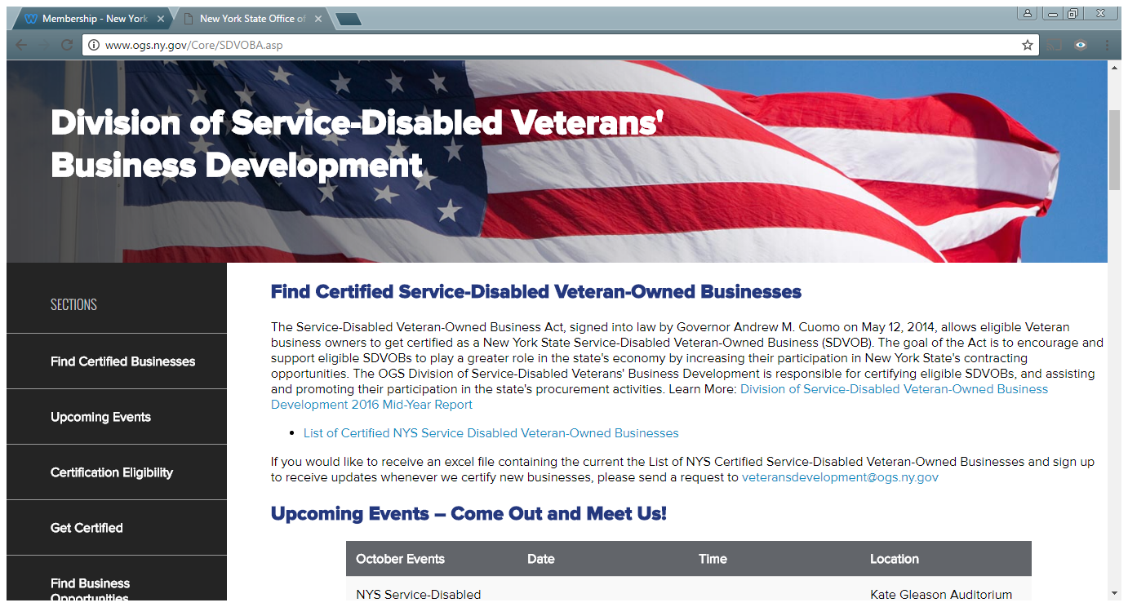

Slide 16
How to Get Work with NYS – Step 1
Project Credibility
Website and Contact Portals
Attitude
NAICS Codes
Geographic Reach
Capabilities Statement

Slide 17
Types of Procurements with NYS
Prime Contracting
Discretionary Spend
P Card (SDVOBs on Centralized Contracts)
Sub Contracting
Set Asides

Slide 18
How to Get Work with NYS – Step 2
Do Research and Reach Out
See what NYS Buys and who buys it at:
Open Book New York www.openbookny.com
Attend events that connect NYS buyers to businesses
Contact purchasing and compliance personnel within agencies
Build relationships with buyers

Slide 19
How to Get Work with NYS – Step 3
Stay up to date on Opportunities
Contract Reporter notifications
Maintain contact with relationships
Attend events

Slide 20
Keys to Long-term Success
Job Performance
Deliver as promised when promised
Be someone people want to deal with
Paperwork Performance
Know what is required
Make timely submissions

Slide 21
Keys to Long-term Success
Everyone Working Together to Make This Work
DSDVBD certifies SDVOBs and works with NYS entities to implement
NYS entities review certified SDVOBs to identify opportunities with contacting needs
SDVOB markets by doing research, building relationships and staying informed

Slide 22
Getting
Certified

Slide 23
Key Certification Information
DSDVBD is averaging 40 working days from the receipt of an application to the decision on certification
The Executive Director personally visits over 70% of the applicants prior to his decision on certification
DSDVBD staff are all veterans and are there to help
When in doubt submit the application and the staff will help get it right

Slide 24
For the:
Application (Downloadable and Fillable)
FAQs
List of SDVOBs
Upcoming Events
Go to ….. OGS.NY.GOV

Slide 25
Scroll Down

Slide 26
Click Here

Slide 27
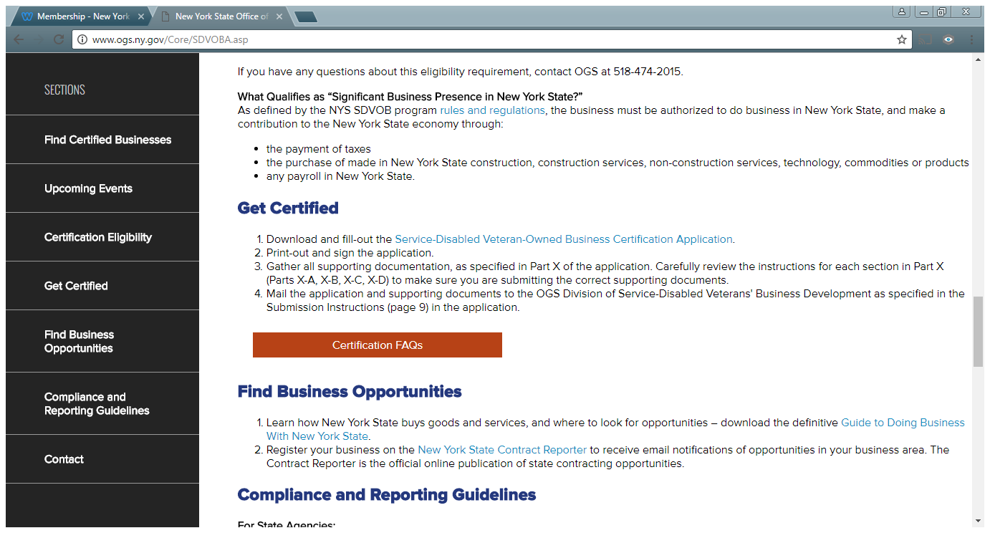

Slide 28
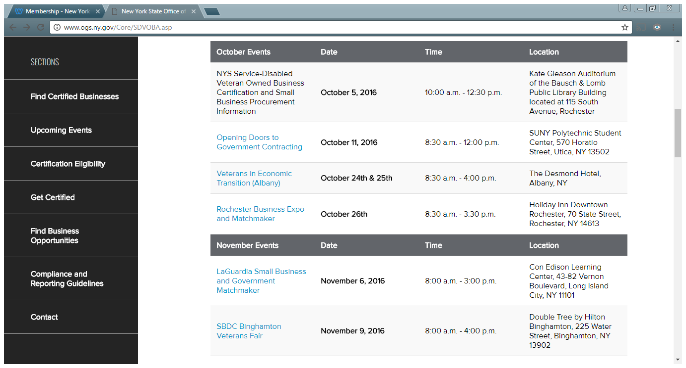

Slide 29
Pathways to Certification

Slide 30
The Supply Problem
The number of SDVOBs needs to increase significantly to enable Agencies and Authorities to accomplish the 6% goal
Many veteran-owned businesses exist that are not aware of the program and do not promote their veteran status
Many older veterans would likely qualify for a service-connected disability of 10% or more
There is no directory of veteran-owned businesses

Slide 31
The Solution
Ask all businesses if they are veteran owned
Encourage veterans who do not have a VA disability rating to apply for one
Since 70% of military personnel recently getting out of the service will have a qualifying service-connected disability, encourage them to start a business
Reach out to veteran and entrepreneurial related organizations to “spread the word”
Work together and communicate

Slide 32
DSDVBD is Here to Help
Let us know about opportunities to speak at and/or attend veteran and entrepreneurial events in your area
Put us in contact with veterans who may be reluctant
Call or email with any questions
We can accomplish great things together

Slide 33
Our Contact Information
Division of Service-Disabled Veterans’ Business Development (DSDVBD)
Email: veteransdevelopment@ogs.ny.gov Phone: 518.474.2015
Address: 32nd Floor, Corning Tower, ESP, Albany, NY 12242
Kenneth Williams, Executive Director
kenneth.williams@ogs.ny.gov
Anthony Tomaselli, Senior Program Specialist
anthony.tomaselli@ogs.ny.gov
Michael Mullen, Program Specialist
michael.mullen@ogs.ny.gov

