Slide 1
VETERAN AFFAIRS EDUCATION OVERVIEW
October 6, 2016

Slide 2
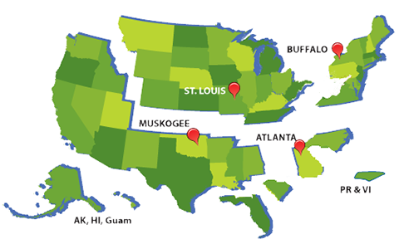
REGIONAL PROCESSING OFFICE JURISDICTION
Notes:
Four offices- Buffalo 12 plus foreign
Over 250 employees-process claims, provide liaison assistance, telephone service to foreign
Process all education benefits- 32, 35, 1606, 1607, 33
All benefits represent commitment to ensuring all servicemembers receive a useful edu with the burden of student loans for civilian life

Slide 3
POST-9/11 GI BILL TRANSFORMATION
Signed into law July 2008- Began making payments August 2009.
A 21st Century education benefit program that delivers a benefit package, rivaling all other education benefit programs since the WWII Era GI Bill in 1945.
- Tuition and Fees
- Yellow Ribbon
- Book & Supplies
- Monthly Housing stipend
A tiered based benefit program based upon number of days service on active duty.
Created and established equality between regular active duty members and activated National Guard and Reserve members.
Notes:
-No other benefit has provided more assistance than the Post 9/11- since original signed in 1944
What is 33?- benefit package not monthly rate… based upon # days service- minimum being 90 days- helped with 9/11 folks called
T and F- Directly to school up to state cap
Yellow Ribbon- beyond state cap
Books and supplies- 1000.00
monthly housing- e5
36 mons-elig for 15 years
Increased transferability- may have already received degree- incentive –spouse or child

Slide 4
GI Bill Payment Rates
BENEFIT | FULL-TIME RATE
CHAPTER 33 | Public – All Tuition & Fee Payments for an in-state student (Subject to benefit Level) Private or Foreign – Up to $21,970.46 per academic year
CHAPTER 30 | $1857.00
CHAPTER 35 | $1024.00
CHAPTER 1606 | $369.00
CHAPTER 1607 | SUNSETTING 2019
Notes:
I just wanted to demonstrate the massiveness of the Post 9/11 in the next couple of slides
Chapter 33- ALL T and F…whereas the next closest benefit is Ch 30…1606- reservists once were at

Slide 5
POST-9/11 GI BILL AVERAGE VALUE COMPARISON
The maximum value of the Chapter 30 GI Bill:
Current Chapter 30 value: $1857/mo x 36 months = $66,052
Average cost of Post-9/11 GI Bill for individual with 100% tier benefit attending a private institution:
Tuition & Fees: $21970.46 x 3 years = $65911.38
Average National Housing: $1611.00 x 36 months= $57996.00
Books & Supplies: $1000 x 3 years = $3000.00
TOTAL AVERAGE VALUE OF POST-9/11 GI BILL = $126,907.38
Notes:
Double the benefit

Slide 6
FY 2011 – FY 2015 Trainees/Dollars Paid
Benefit | Education Programs | FY 11 Trainees Dollars Paid | FY 12 Trainees Dollars Paid | FY 13 Trainees Dollars Paid | FY 14 Trainees Dollars Paid | FY 15 Trainees Dollars Paid
Chapter 30 | Montgomery GI Bill (MGIB)-AD | 185,220 / $1.4B | 118,549 / $932M | 99,755 / $775M | 77,389 / $512M | 61,403 / $442.2M
Chapter 32 | Veterans Educational Assistance Program (VEAP) | 112 / $1.3M | 76 / $682K | 29 / $496K | 8 / $359K | 4 / $35K
*Chapter 33 | Post-9/11 GI Bill | 555,329 / $7.7B | 646,302 / $8.5B | 754,229 / $10.2B | 790,408 / $10.8B | 790,507 / $11.2B
Chapter 35 | Survivors’ and Dependents’ Educational Assistance Program (DEA) | 90,657 / $463M | 87,707 / $455M | 89,160 / $483M | 90,789 / $514M | 91,755 / $493.2M
Chapter 1606 | Montgomery GI Bill Selected Reserve (MGIB-SR) | 65,216 / $201M | 60,393 / $157M | 62,656 / $156M | 63,745/ $150M | 63,030 / $141.1M
Chapter 1607 | Reserve Educational Assistance Program (REAP) | 27,302 / $95M | 19,774 / $77M | 17, 297 / $70M | 13,784/ $56M | 9,965 / $40.5M
 | Veterans Retraining Assistance Program (VRAP) | N/A | 12,251 / $6.1M | 67,918 / $428M | 52,288 / $413M | N/A
Total |  | 923,836 / $9.8B | 945,052 / $10.1B | 1,091,044 / $12.1B | 1,088,411 / $12.4B | 1,016,664 / $12.3B
As of July 7, 2016, VA issued $65 billion in Post-9/11 GI Bill benefit payments to 1,597,874 individuals since program inception (August 2009).
3

Slide 7
Claims Processing Highlights
Claims Inventory | FY13 | FY14 | FY15 | FYTD through May 2016
Claims Processed | 4.5M | 4.3M | 4.2M | 2.6M
Original Claims Timeliness (Average Days to Complete) | 26.2 | 16.7 | 18.4 | 16.5
Supplemental Claims Timeliness (Average Days to Complete) | 9.7 | 5.9 | 7.0 | 6.6
Payment Accuracy | 98.7% | 98.7% | 99.4% | 99.03%
Claims Processed
 | Original | Supplemental
April | 27, 395 | 251, 037
May | 28,600 | 274,030
*Data represents all EDU claims
abill
4

Slide 8
PRINCIPLES OF EXCELLENCE
This Presidential Order directs VA, DOD, ED, DOJ and CFPB to work together to strengthen oversight and accountability within veteran and military education programs.
Ensures educational institutions are providing meaningful information to students
Assists students in making choices about federal education benefits
Prevents abusive recruiting practices that target veterans and families
Notes:
So this huge amount of money…more accountability for all of us-ensuring doing right by veteran
Principles of Excellence- Eo 13607 issued by Obama 4/27/12
Over the next several years, the number of service members transitioning from military life to civilian life is expected to increase significantly.
-A growing number of these veterans will be enrolling at America’s Colleges and Univ…as they seek to become career ready and improve their future prospects for employment. For these vets, access to higher edu is important but is not enough…we must help our veterans obtain a degree, certificate or license..These credentials are valued by employers and serve as a key milestone to future career success..
You all play a critical rold in ensuring veterans have access to high qaul edu and post sec ops.
VA will continue to build on its work to ensure veterans success by acting on our commitment to place higher ed within reach for all…Together we are all united in making sure this generation of veterans and fam are aware of and take advantage of all the benefits and resouces provided for this grateful nation.

Slide 9
GI Bill® Comparison Tool
Comparison Tool was launched on February 4, 2014, in response to Executive Order 13607 to implement and promote “Principles of Excellence.” As of July 4, 2016, it had over 3,194,719 unique page views to over 1 million users.
Recently added functionality:
On November 11, 2015, VA released a complete redesign of the Comparison Tool featuring:
School profile page
Student outcome measures
Enhanced search and print functionality
Mobile/tablet compatibility
A new look to the benefits calculator
The Comparison Tool is updated to include the use of a caution flags:
Settlement with U.S. Government - EDMC
Heightened cash monitoring
Accreditation probation
DoD probation for military tuition assistance
FTC suit- DeVry Institute
Department of Education notice of intent- DeVry Institute
Flight Programs – Suspended for 85/15 violation
17

Slide 10
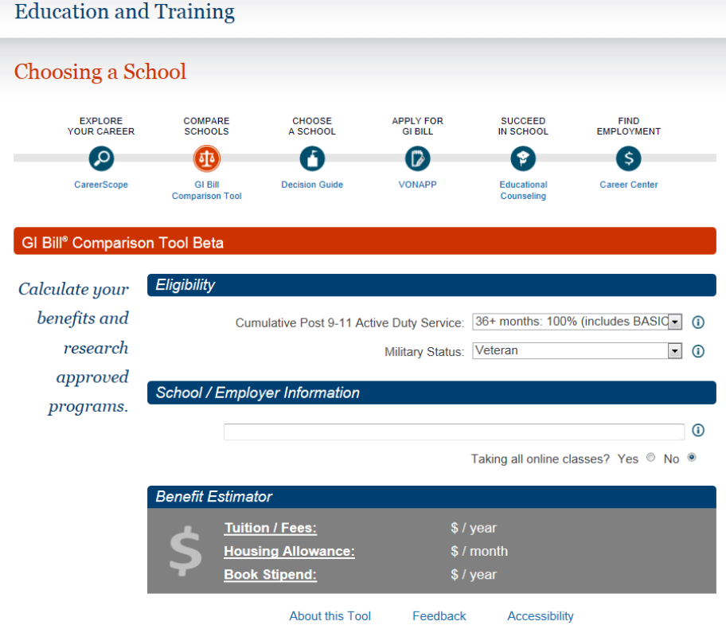
GI Bill® Comparison Tool
Notes:
Where are students veterans enrolled? 79% stuedent vets are attending public schools…remaining 21 equally split bt nono profit and proprietary schools…

Slide 11
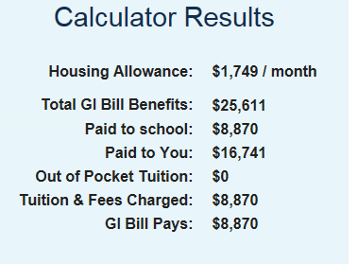
GI Bill® Comparison Tool

Slide 12
GI Bill® Comparison Tool (cont.)
Future releases will include:
School Ratings
Enhanced Data Service
More Caution Flag Information
School Certifying Official Contact Information
Detailed Accreditation Information
Major/Program type
https://www.vets.gov/gi-bill-comparison-tool
18

Slide 13
GI Bill® Feedback System
On January 30, 2014, VA launched the Feedback System to intake student complaints concerning non-compliant POE schools
Total complaints as of June 30, 2016: 6,345
Of these:
POE complaints: 4,002 (63%)
Pending: 47
Active: 102
Non-POE complaints: 2,343 (37%)
Risk-based reviews conducted as of June 30, 2016: 122
11 withdrawals
GI Bill Feedback System Observations:
Communication ̶ Issues between school staff and students
Financial issues – Timeliness of certification submission
Transfer of credits – General lack of understanding by students
Refund issues – Administration with multiple types of financial aid (Title IV & VA)
15

Slide 14
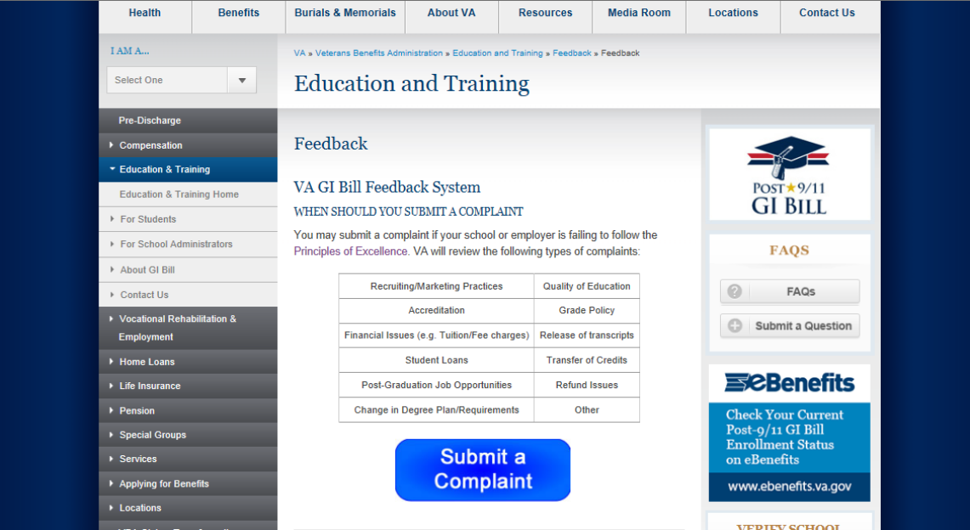
GI Bill® Feedback System
Notes:
When a student wishes to submit a complaint they will need to select what type of issue they are having…should be more than I waited too long for my check…specific to quality of edu, grade policy, transfer of credits…

Slide 15
GI Bill® Feedback System (cont.)
Complaints by Issue (June 2016)
Post-Graduation Job Opportunities | 436
Release of Transcripts | 311
Transfer of Credits | 562
Student Loans | 732
Change of Program | 410
Grade Policy | 378
Accreditation | 599
Recruiting/Marketing Practices | 730
Refund Issues | 624
Quality of Education | 1135
Other | 1094
Financial Issues (e.g. Tuition/Fee Charges) | 2153
16

Slide 16
CareerScope
In addition to Career Counseling, the Department of Veterans Affairs provides the interest and aptitude assessment tool known as CareerScope at no cost to all eligible benefit recipients.
Notes:
CareerScope has been used frequently by Veterans to determine the best career path for transition to civilian life. Pilot launched Augusty 2013.
Whether you wish to pursue education and training in a field you already know, or you wish to branch out to other fields that interest you, CareerScope can help. With CareerScope you will be provided with an assessment of your interests and aptitudes, and given recommendations about which careers you may enjoy and be successful doing, and what courses or training programs you should focus on to pursue those careers.

Slide 17
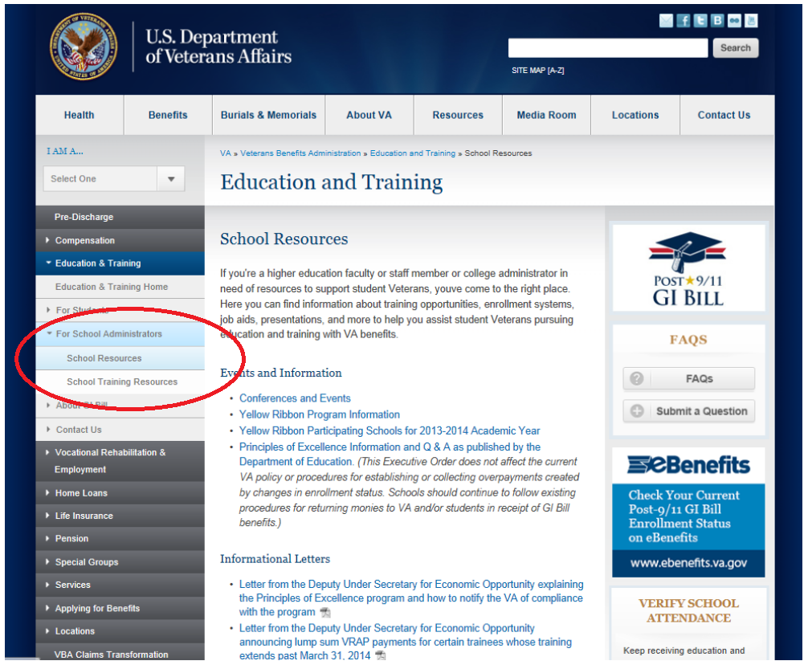
SCHOOL ADMINISTRATOR RESOURCES

Slide 18
VA CAMPUS TOOLKIT
Notes:
Helpful tool for college administrators….provides information as to who is using GI Benefits….where they are enrolled as well as characteristics of student veterans….For ex. Only 15% of student veterans are traditionally aged students…most student vets are between 24 and 40 and 62 percent of student vets are first generation students…

Slide 19
CLOSING REMARKS
The commitment made by colleges and universities will help Veterans better transition from military service into the classroom, graduate, and find a rewarding career to help strengthen our economy.
Given the opportunity, Veterans will succeed because they possess exceptional character, team-building skills, discipline, and leadership.
Notes:
Over the next several years, the number of service members transitioning from military life to civilian life is expected to increase significantly.
-A growing number of these veterans will be enrolling at America’s Colleges and Univ…as they seek to become career ready and improve their future prospects for employment. For these vets, access to higher edu is important but is not enough…we must help our veterans obtain a degree, certificate or license..These credentials are valued by employers and serve as a key milestone to future career success..
You all play a critical rold in ensuring veterans have access to high qaul edu and post sec ops.
VA will continue to build on its work to ensure veterans success by acting on our commitment to place higher ed within reach for all…Together we are all united in making sure this generation of veterans and fam are aware of and take advantage of all the benefits and resouces provided for this grateful nation.

