Slide 1
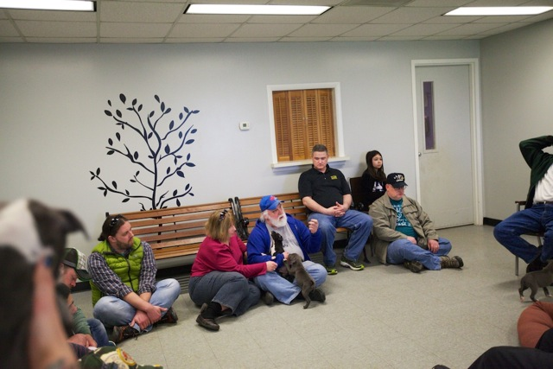
‘This program is as much for the veterans as it is for the dogs’: Initial findings from Dogs Tags Niagara
Thomas H. Nochajski, PhD
Joe Ruszala
Jacob Silver
Braden K. Linn, MCMP, MSW

Slide 2
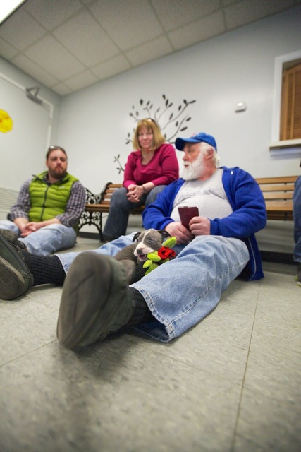
Aims
To investigate some of the changes associated with the program
To provide insights to maintain and grow the program
To provide insights for developing other veteran-SPCA partnerships

Slide 3
Background
Several lines of research have found that, for veterans, interactions with animals are associated with positive health and mental health outcomes, including reduced loneliness (Banks & Banks, 2005).
These reports are also buttressed by other anecdotal reports in the popular press (Russell, 2013; Westlund, 2014)
and seem consistent regardless of what kind of animal a veteran interacts with.
Indeed, a recent review indicated that pet ownership and pet therapy confers a number of benefits in the areas of physical, emotional, and social health (Cherniack & Cherniack, 2014).
Animals also seem to have a positive effect on mood during deployments for active duty service members (Fike, Najera, & Dougherty, 2012)

Slide 4
Background
Complementary lines of research have suggested that other helpful ways for veterans to reintegrate following military service include maintaining relationships with other veterans and engaging in service (Hinojosa & Hinojosa, 2011).
Community service, in particular, has been suggested as a way to engage veterans and help with the reintegration process (Doa, 2011).
Previous research has found that both service and interacting with other veterans helps improve the quality of relationships a veteran has with family.
Taken together, the extant literature suggests that a program that engaged veterans in service, permitted them to interact with peers, and had a component with animals would yield positive outcomes.
Such components are evident in a program known as Dog Tags Niagara that exists in western New York State.

Slide 5
Study Design
The purpose of the study was to determine the impact of the program on the veterans and the dogs.
In order to accomplish this, we wanted to interview the following types of individuals:
veterans, in order to gain an understanding of what this program did for them and the aspects they felt were critical for them;
the staff of the SPCA, to identify how the work of the veterans was perceived by the staff working at the SPCA, and also get their perceptions of the veterans;
The individuals who adopted the dogs the vets were working with to gain some insights into how the dogs were doing in their adopted homes.

Slide 6
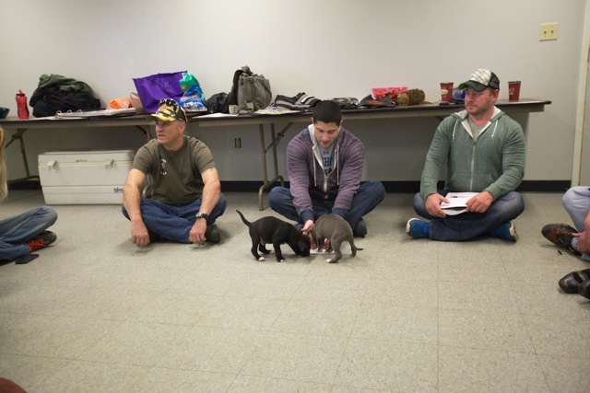
Participants
There were a total of 23 participants,
with 13 veterans,
10 staff
and only one individual who adopted one of the dogs.
Mean age: 37.05 (range: 23-67)
Participants were primarily white (96%)
Only one of the veterans was a female, while all of the staff were females and the 1 individual who adopted a dog was also a female.

Slide 7
Procedures
Semi-structured interview guides were developed to elicit feedback from stakeholders about their experiences with Dog Tags Niagara
We interviewed:
Veterans who volunteer with the program
Dog Tags Niagara Leadership
Niagara County SPCA leadership
people who adopted dogs from the shelter
Interviews were conducted 1:1 or in groups from August-November 2014
Participants had the choice to speak with a veteran or a civilian
A $10 gift card was provided as an incentive
UBSBSIRB approved our protocol

Slide 8
Procedures
Individual interviews were conducted with the majority of participants, although two groups were also completed using three interviewers/observers.
A semi-structured interview, tailored to each of the groups (veterans, staff, adoption) was used to get at specific information of interest for this study.
The veteran guides was designed to investigate each veteran’s personal experience in the program, and their overall impressions of the program. This included how they experienced working with the dogs, what did this mean for them, how did it help them in their everyday life;
Staff members were asked questions aimed to elicit observations of the veterans involvement with the program – impact on the vets and the dogs;
The questions for the adopters were focused on the welfare of the animal and their satisfaction with the dog.

Slide 9
Results
Veterans get involved with the program because of a commitment to service and a belief that it might be beneficial to them:
I have been looking for something to do on a volunteer basis…I wanted something to get me out of the house. And I like animals so I thought it would be a good fit. [male veteran]

Slide 10
Results
Other veterans became involved because of the changes they thought it might produce in themselves
I was in a bad place…I didn’t want nothing to do with nobody…I remembered Joe, so I asked him if the Dog Tags program was still going on and he said, ‘yeah.’ So I told him I’d like to be a part of it and it might be beneficial to me to be around animals. [male veteran]

Slide 11
Results
Many of the veterans pointed out the similarity between veterans and pit bulls.
[it’s] being able to connect with some of the animals, getting rid of that stigma that certain people have about a certain breed. You know a lot of people have that feeling about veterans with PTSD, that we are damaged goods or there is something wrong with us. [male veteran]
“….a lot of these dogs that are in here are thrown away. Nobody wants to deal with them or their problem, just like veterans….”

Slide 12
Results
Veterans stay involved because of changes they see in themselves and the connections they make.
I am just relaxed [at the shelter]. My guard is down…I just feel more at ease when I am here as opposed to other places when I am around complete strangers. It’s not only the relationship with the dogs, it’s also the relationship with the people that are working here.
I was less snappy, less aggressive.
I can leave my house and do something like this…I don’t just sit around my house and think anymore. I am up here trying to make a difference.

Slide 13
Results
Many participants indicated that one of the reasons they get involved and stay involved with the program is the chance to interact with other veterans. One male veteran explained,
“…it’s nice coming here and everyone has the same mindset and we know what we have to do. We work together like an actual group.”
A staff member affirmed the relationship that develops between veterans in the program, “…it’s a huge family…and that extends to our volunteers…and our Dog Tags volunteers as well.”

Slide 14
Results
Veterans also stay involved because of the positive changes they see in dogs:
She was a really nice dog, but when I met her. She was really afraid and nervous and skittish around people and once I began working with her that fear went away.
…Frieda [a dog] didn’t like her legs being touched. So I would show her that [petting her] is nothing to be scared about. And slowly but surely over time she got rid of that fear of being touched.

Slide 15
Results
Service continues to be a part of why veterans stay involved:
My goal is to give each one of these guys a second chance to they are not sitting in these kennels
One Staff Member explained
“They bring a lot of man power that wasn’t previously here.”
They are really great about getting out into the community and they are representing not only the program but the SPCA everywhere they go.”

Slide 16
Results
One of the key attractions for the veterans was the flexibility of the program and the ease of entering (few barriers)
“…[with] this program, there is less stress. You just come in and you unwind with the dog and there’s no one telling you can’t do this, you can’t do that, you’re not qualified to take this dog out.”
“Everyone has their own little thing that they like to do [with a dog]…we kind of really loosen our strings to help, and to fit the vets, knowing that they can’t be at the shelter all the time. ‘Do what you can with them [the dogs]’…it seems to be working out pretty good.”

Slide 17
Challenges
Attracting more female veterans –
Males have been getting together for a number of years – but for women – it’s something new. Need to figure out how the women can be recruited.

Slide 18
Challenges
When a dog gets adopted – mixed emotions – they get attached and now the dog is going away – happiness because the dog is adopted – sadness because they will no longer be interacting with the dog –
“It’s a great feeling but it’s like sometimes you hate to see them go, but then you’re excited when they do go. It kind of tugs at your heart a little bit, but you know that they are going to be happy—knowing that they are finally out of a place like this.”

Slide 19
Challenges
A staff member corroborates the plethora of emotions that accompany a dog’s adoption
, “…these guys [veterans], create such a bond, especially if it’s a dog that they have watched the entire transformation from beginning to end. I have seen the emotion on their faces—it’s like their [own] dog is finding a new home or something.”

Slide 20
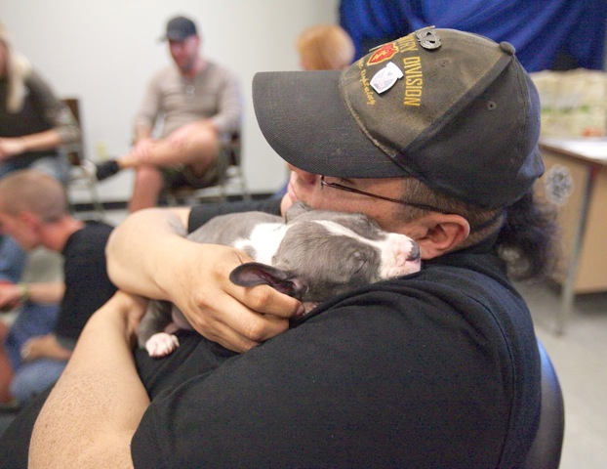
Initial conclusions
Veterans share a kinship with dogs—especially pit bulls—because of the perception that they are disposable
The flexibility and low barriers to entry are part of the strengths of the Dog Tags Niagara program
The positive changes associated with the program can be attributed to the sense of community, and devotion to service

Slide 21
Limitations
Data are cross-sectional and may not be free of response bias
Potential utility of the findings
Inform the development of other veteran-animal shelter partnerships in other locales
Inform intervention research with veterans

Slide 22
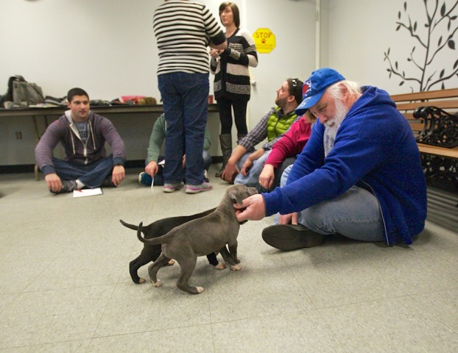
Thank you
Questions? Comments?
bradlinn@buffalo.edu
thn@buffalo.edu
p51hoarse@hotmail.com

