Slide 1
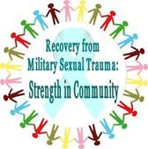
Military Sexual Trauma (MST)
Rebecca Welch, LCSW
VAMC Western New York
MST Coordinator
Transition and Care Manager

Slide 2
Introduction MST Video

Slide 3
What is MST?
VA’s definition of MST comes from U.S. Code. In general is sexual assault or repeated, threatening sexual harassment that occurred during a Veteran’s military service.
MST can occur on or off base, while a Veteran was on or off duty
Perpetrators can be men or women, military personnel or civilians, Commanding Officers or subordinates, strangers, friends, or intimate partners
Veterans from all eras of service have reported experiencing MST

Slide 4
How Common is MST?
This can be difficult to know, as sexual trauma is frequently underreported
About 1 in 4 women and 1 in 100 men have told their VHA healthcare provider that they experienced sexual trauma in the military.
Although women experience MST in higher proportions than do men, because of the large number of men in the military there are significant numbers of men and women seen in VA who have experienced MST.

Slide 5
VA’s Response to MST
VA is legally mandated to provide treatment for conditions related to MST, provide staff with training on MST, and engage in outreach to Veterans about services available
VA has also established national policy:
All Veterans seeking VHA care must be screened for MST
All treatment (including medications) for physical and mental conditions related to MST is free, with no limit on duration
Every facility must have a designated MST Coordinator to serve as a point person for MST issues at the facility

Slide 6
What is the Impact of MST?
There is no one way that Veterans respond to MST
Many cope quite well and recover without professional help
Some continue to have difficulties at times or strong reactions to certain situations
Some experience more profound or longer-term problems
May be particularly likely for Veterans with multiple traumas
People are remarkably resilient after experiencing trauma

Slide 7
What are Some Effects of MST?
Mental Health | Physical Health | Psychosocial
Post-traumatic stress disorder | Gastrointestinal problems | Unemployment
Depression | Headaches, Chronic pain | Relationship problems
Substance use disorders | Sexual dysfunction | Spirituality issues
(MST Support Team; Kimerling et al., 2011)
Notes:
FY11 data:
PTSD: 46.99% of women, 45.74% of men
Major Depression: 20.6% of women, 14.7% of men
Schizophrenia and Psychoses: 4.77% of women, 10.68% of men
Substance Abuse: 4.63% of women, 9.92% of men
Mania/Bipolar Disorders: 7.04% of women, 5.2% of men

Slide 8
What Can You Do?
Maintain awareness of the issue
Convey that you and others care about MST
Allow the person to maintain confidentiality with you regarding their experience, if they disclose to you
Notes:
Recognize that the VA can often bring back memories of military service, and in some cases MST, making it a trigger for some Veterans seeking care (for MST or other health conditions).
Be sensitive to MST disclosures- many veterans report invalidating responses to reports of sexual harassment or assault in the military. We don’t want to repeat the experience for them. Take all disclosures or inquiries seriously. If you have questions, refer to MST coordinator.

Slide 9
What Can You Do?
Respond Supportively
Veterans may feel that others’ hurtful and insensitive reactions to disclosures of MST can be as damaging as the MST itself
Lack of support after experiencing trauma increases the likelihood of developing PTSD
“Victims may be better off receiving no support at all than receiving reactions they consider to be hurtful.”
(Campbell, Ahrens et al., 2001, p. 300)

Slide 10
How to Respond to Disclosure
You may be the first person the survivor has ever told about his or her experiences. An empathic, supportive response has the power to be tremendously healing.
Provide validation and empathy: “I’m sorry this happened to you.”
Provide education and normalization: “Many Veterans have had experiences like yours and for some, it can continue to affect them even many years later. People can recover, however.”
Assess social support: “Have you ever been able to talk to anyone about this before?”

Slide 11
Responses to Disclosure (cont.)
Offer assistance with services: “Some of the Veterans I’ve met have found it helpful to talk with someone about their experiences. The VA offers free counseling related to MST. Would it be okay if I give you information about our local MST Coordinator? After talking with him/her about your options, you could decide if you wanted to take it any further.”
Not everyone needs counseling: “If you ever change your mind and want to speak to someone, just let me know.”
Know who is available for help…
MST Coordinator
Primary Care Clinics
Mental Health Treatment
Emergency Department

Slide 12
Recovery is possible…
VAMC’s across the country offer specialty PTSD and MST treatment services in a variety of settings.
-Outpatient mental health
-Individual and Group Counseling, Psychiatry
Residential treatment (Batavia, NY)
Inpatient treatment
Vet Centers
WNY FY14 data reports:
-64.7% of female patients and 44.1% of male patients who screened positive for MST engaged in Mental Health treatment in WNY.
-Data suggests a 6.3% increase in females and 7.1% increase in males receiving MST treatment from FY10 to FY14.

Slide 13
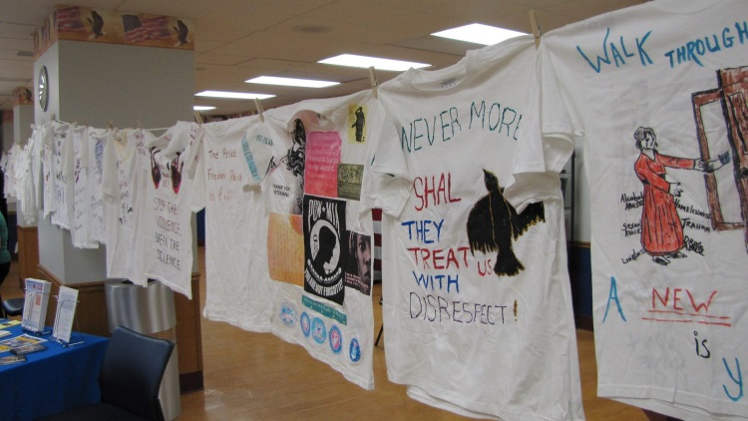
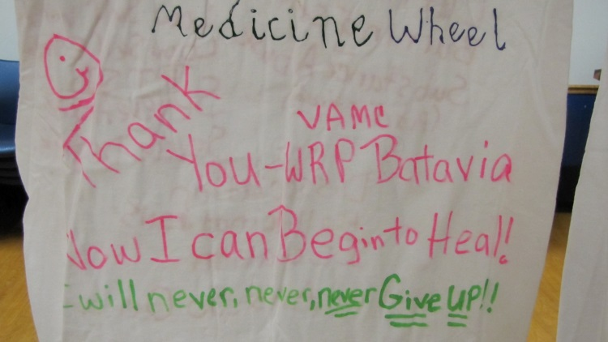
WNY awareness efforts
Every April, WNY hosts a “Clothesline Project” event to raise awareness about MST amongst Veterans and staff members. Over 100 shirts created by MST survivors are displayed.
Join us on April 20th at the Buffalo VAMC for the event! ☺

Slide 14
More Information
VA Internet website
www.mentalhealth.va.gov/msthome.asp
Information for Veterans, public, family members

Slide 15
Questions/Comments
Questions or comments?
If you have further questions about MST or want assistance with a referral, please contact:
Rebecca Welch, LCSW
716-862-7452
Rebecca.Welch4@va.gov

